Slide 1
Laptop Price Prediction
ML Case Study, Insights and Recommendations

Slide 2

Business Overview
SmartTech Co. has partnered with our data science team to develop a robust machine learning model that predicts laptop prices accurately.
As the market for laptops continues to expand with a myriad of brands and specifications, having a precise pricing model becomes crucial for both consumers and manufacturers.
With this in mind, we have worked on a ML project to come up with a model that can accurately predict prices of laptops based on the specifications entered by the user / client.
Notes:
Photo by <a href="https://unsplash.com/@wasdrew?utm_content=creditCopyText&utm_medium=referral&utm_source=unsplash">Andras Vas</a> on <a href="https://unsplash.com/photos/macbook-pro-turned-on-Bd7gNnWJBkU?utm_content=creditCopyText&utm_medium=referral&utm_source=unsplash">Unsplash</a>

Slide 3


Client Objectives & Challenges
Objectives
Key Challenges
Accurate Pricing: Develop a model that can accurately predict laptop prices based on various features, helping our clients stay competitive in the market.
Market Positioning: Understand how different features contribute to pricing, enabling SmartTech Co. to strategically position its laptops in the market.
Brand Influence: Assess the impact of brand reputation on pricing, providing insights into brand perception and market demand.
Diverse Specifications: The dataset encompasses laptops with diverse specifications. Our challenge is to build a model that generalizes well across a wide range of features.
Real-time Prediction: The model should have the capability to predict prices for newly released laptops, reflecting the fast-paced nature of the tech industry.
Interpretability: It is crucial to make the model interpretable, allowing SmartTech Co. to understand the rationale behind pricing predictions.

Slide 4





Flow of the Presentation
Insights – Summary
Insights – Deep Dive
Machine Learning Model
Interface for Laptop Price Prediction
Recommendations – The Way Forward

Slide 5




Flow of the Presentation
Insights – Summary
Insights – Deep Dive
Machine Learning Model
Interface for Laptop Price Prediction
Recommendations – The Way Forward

Slide 6

Insights - Summary
Factors Influencing the Price of a Laptop
Brand of the Laptop: Certain brands markedly demand a premium, while several others are reasonably priced.
Type of Laptop: The type of laptop (Ultrabook, Notebook, etc) influence a difference in price – certain types influence an increase in price.
Touchscreen & IPS Display: Brands that have Touchscreens and/or IPS displays are priced at a premium and are generally lesser in supply in the market
CPU Brand (Processor): High-end processors demand a premium while low-end processors influence a price decrement
GPU Brand: GPU brand influences a difference in price
RAM: The higher the RAM, the more the price point of the laptop
PPI (Pixels per Inch): The higher the PPI, the more the price of the laptop
RAM and SSD: The higher the RAM and SSD, the greater the Price of the laptop

Slide 7


Flow of the Presentation
Insights – Summary
Insights – Deep Dive
Machine Learning Model
Interface for Laptop Price Prediction
Recommendations – The Way Forward

Slide 8
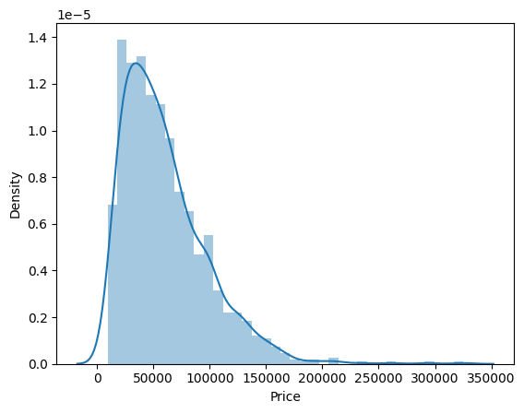
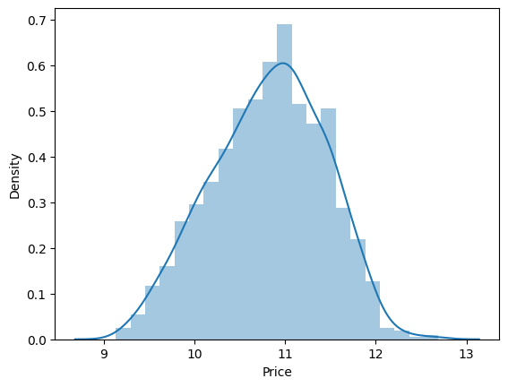
Price is positively skewed (right-skewed distribution)
Price of laptops is a positively skewed distribution.
For predicting the price-points properly, we will be using the log transformation of the price feature, which would convert the right-skewed distribution into a distribution that is more normal / standardized for the sake of better machine-learning

Slide 9
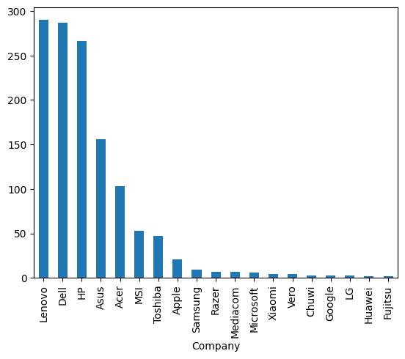
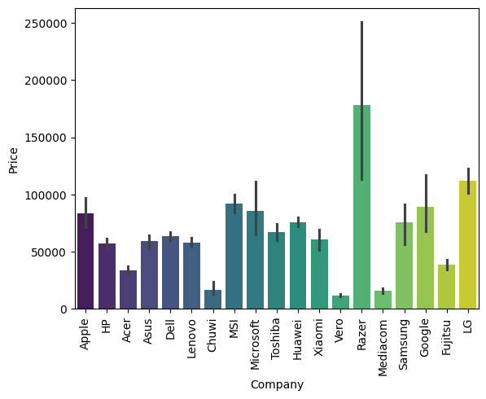
Price varies as the brand of the laptop
Brands like Lenovo, Dell, HP have greater market presence, but are lower priced as they are mass / masstige brands
Brands like Razer, LG, MS, MSI, and Apple have low to moderate presence but are higher priced, on account of their premiumness
Brand therefore influences price points of laptops significantly

Slide 10
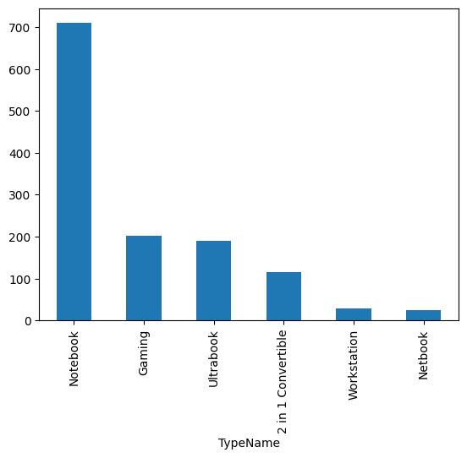
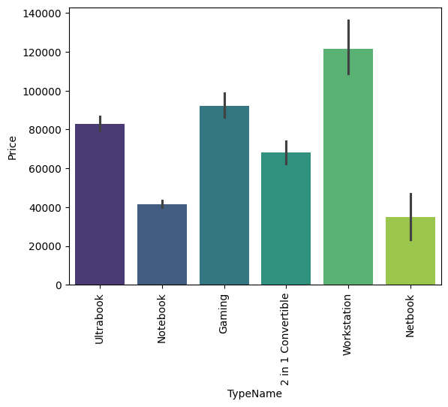
Price is significantly influenced by the type of laptop
Notebooks are the most prominent types of laptops, and are the second-most least priced types of laptop. This is followed by Gaming and Ultrabooks – however these command a higher price
Workstations are the priciest laptops and also the least stocked in the retail outlet
Thus, the type of laptop does influence the price of the laptop

Slide 11
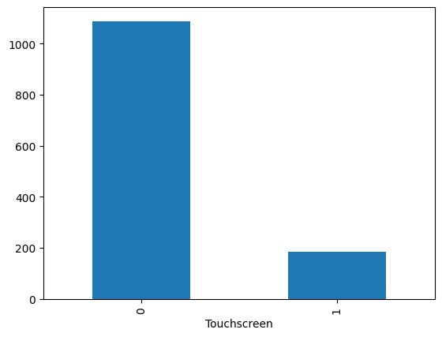
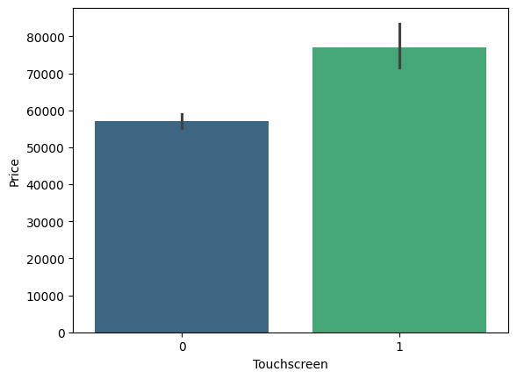
Touchscreen laptops command a higher price than non-touchscreen laptops
Touchscreen laptops are the least stocked laptops; however they command a premium price compared to the non-touchscreen laptops
Price is therefore influenced by whether a laptop has a touchscreen display or not – If it has, it will be higher priced than the model which does not have a touchscreen

Slide 12
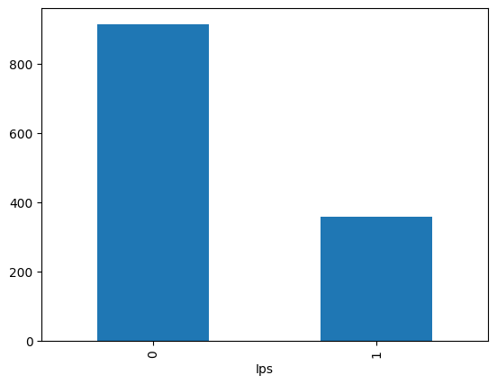
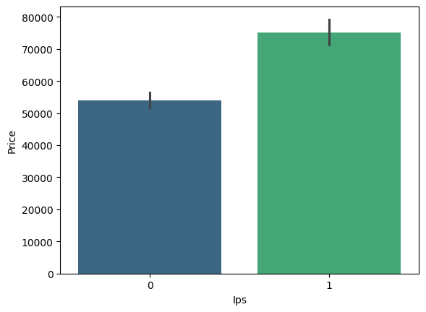
Laptops with IPS displays command a higher price
IPS Displays follow the same trend as Touchscreens – they are fewer in stock, but command a higher price compared to their non-IPS counterparts
Price of the laptop is therefore influenced by this factor of IPS display – if there is an IPS display, the laptop will be higher priced than its non-IPS counterparts

Slide 13
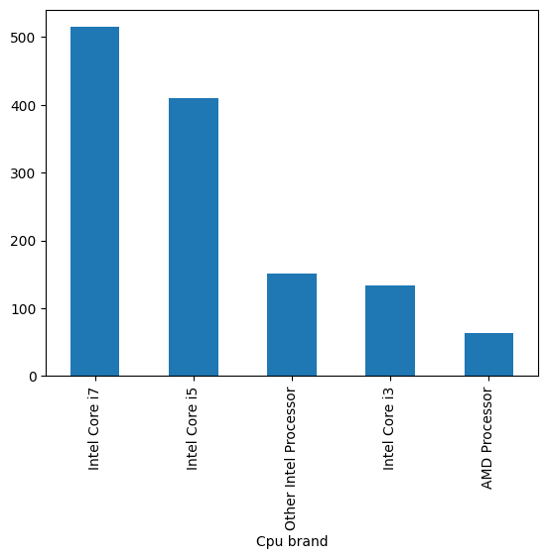
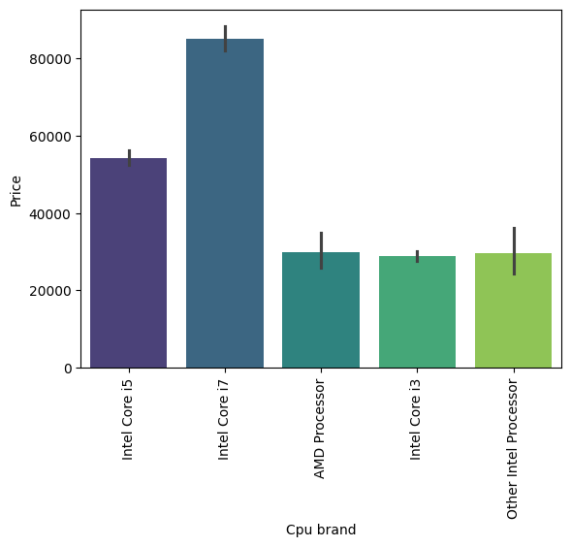
The higher the power of the Processor and its brand, the greater its price
Intel is the dominant CPU (Processor) brand in the market and it commands a premium compared to its competitor AMD.
The higher the power of the processor and if it is an Intel processor, it’s price will increase accordingly.

Slide 14
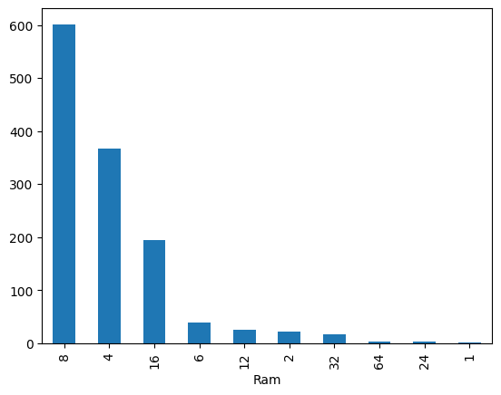
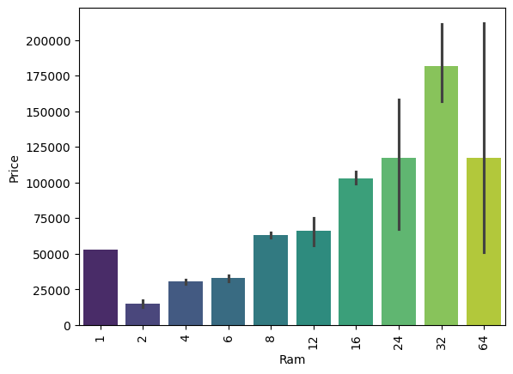
Directionally, higher the RAM, the higher the Price of the device.
While 8GB and 4GB RAMs dominate the market in supply, they are priced moderately and cater to the mass segments of consumers.
16GB, 24GB and 24GB RAMs command a premium, and are lesser in stock in the market as well.
The higher the RAM, the higher the price point of the laptop

Slide 15
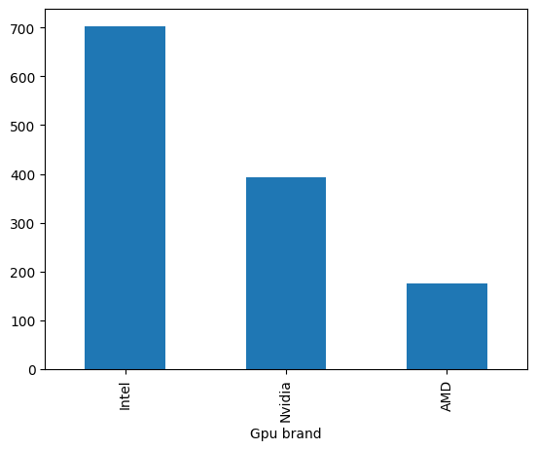
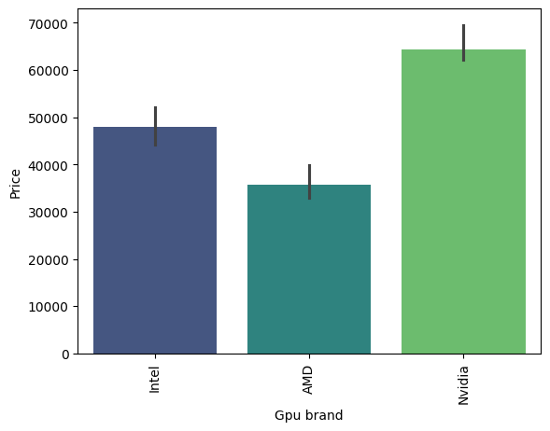
GPU brand impacts the price point of the device
While Nvidia is a moderately dominant brand, it commands a higher price point perhaps on account of better quality
Intel and Nvidia are more dominant in the market and higher priced compared to AMD
This signifies that GPU brand does influence the price of the laptop

Slide 16
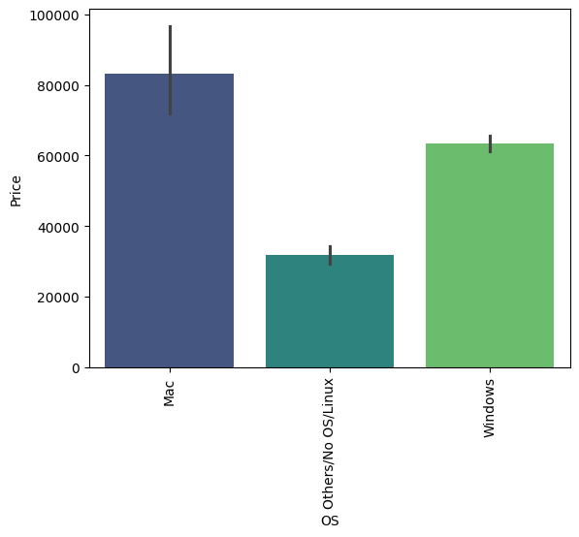
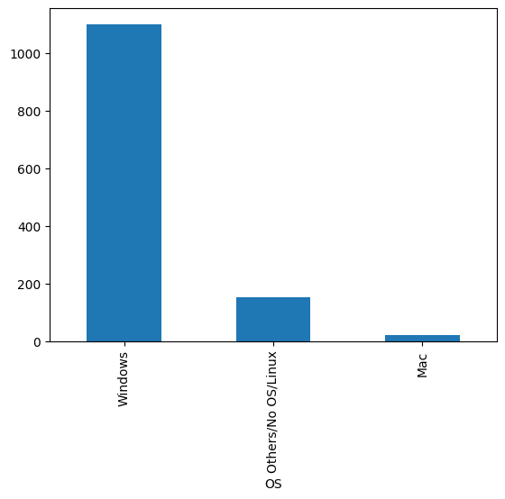
Operating System (OS) impacts the price point of the device
macOS is the highest priced Operating System in the market, followed by Windows. Other OS are not that dominant in the market or as highly priced
Price is influenced by Operating System – a more premium OS will command a higher price

Slide 17
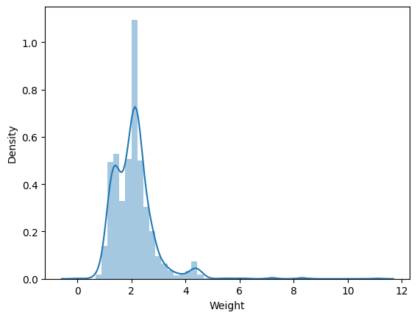
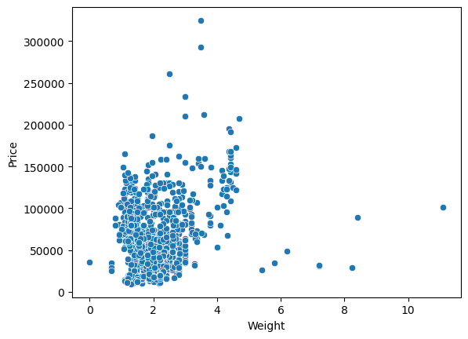
Weight of the laptop may not have a very obvious bearing on the price of the laptop
We cannot clearly say whether weight influences the price point of a laptop. However, it appears like lower the weight, the lower the price point to be expected in case of certain laptops
Most laptops weigh between 1kg to 2.3kg as per the observed data

Slide 18
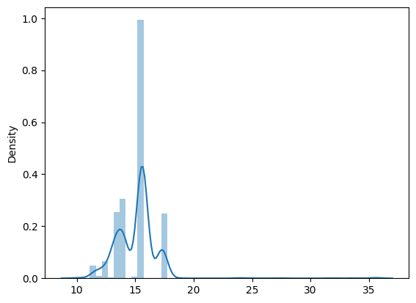
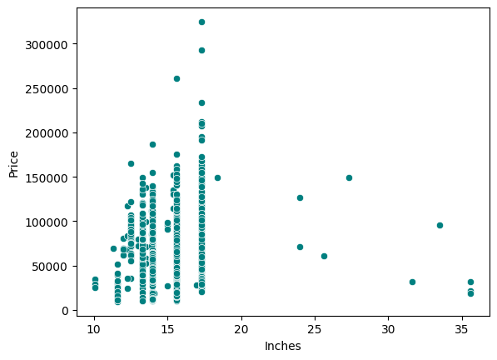
Screen Size does not have a significant impact on price points
Majority of the laptops have a 15in screen-size.
However, this does not indicate that the price of the laptop increases with increase in size of the screen or vice-versa.
Therefore, screen size does not seem to have a major impact on the price of the device

Slide 19
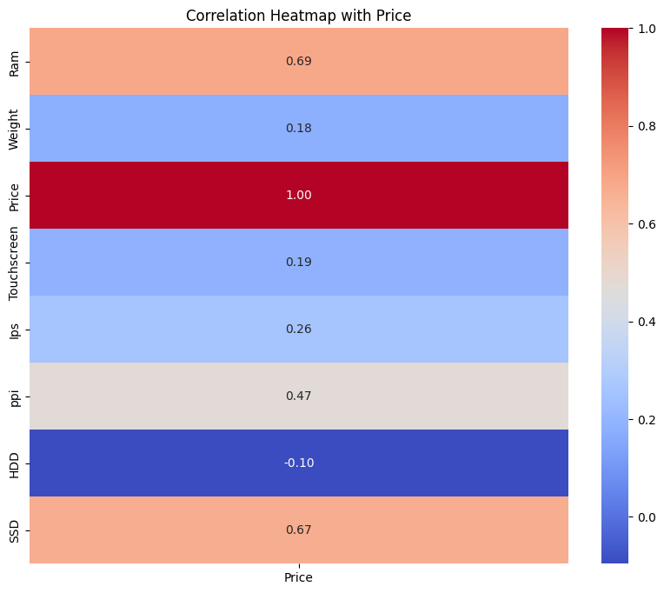
RAM and SSD are the most positively correlated features with Price
The heatmap shows that RAM and SSD have an above average correlation with Price of the laptop. This means that higher the RAM / SSD, the higher the price of the laptop
Conversely, existence of an HDD in the laptop has the potential to bring down its price – which aligns with the fact that HDDs are getting outdated these days
PPI also has a moderate impact on the price point of the laptop
Existence of IPS and Touchscreen are also positively correlated with the price of the laptop, however to a much lesser degree

Slide 20

Flow of the Presentation
Insights – Summary
Insights – Deep Dive
Machine Learning Model
Interface for Laptop Price Prediction
Recommendations – The Way Forward

Slide 21
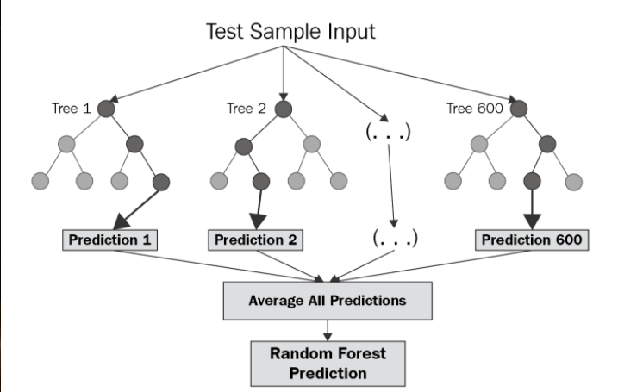
Selected Model: Random Forest Regressor (R2 Score: 0.88)
We trained and tested the dataset on 5 different models namely:
Linear Lasso Regression
K-Nearest Neighbors (KNN) Regression
Support Vector Machine Regression
Random Forest Regressor
Decision Tree Regressor
Out of these, the best fit model was Random Forest Regressor, with R^2 Score of 88% and RMSE of 0.20
We decided to go ahead with this model since it is neither underfit nor overfitting the data and the predictions are largely accurate across all the tested cases
Illustrative Working of Random Forest Regression Models
Note:
We have used 85% of the data for training and 15% of the data for testing.
The model has been trained using scikit-learn library on the Google Colab environment, using Python as the coding language

Slide 22
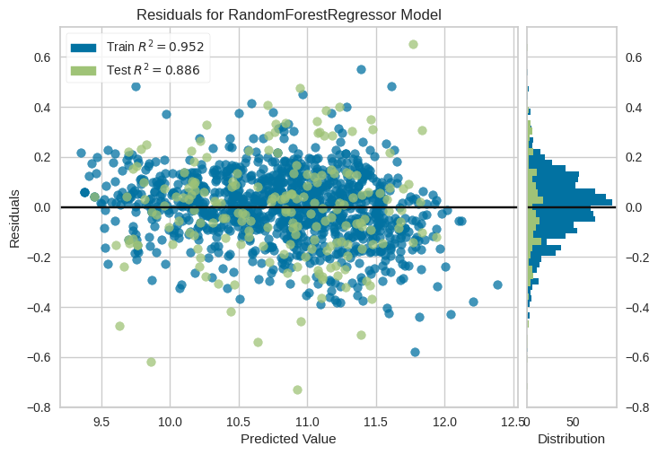
Residuals Analysis
The Residuals Plot for RF Regressor Model depicts the following:
Training Data R2 Score is 95%
Test Data R2 Score is 88%
This shows us that the model is neither overfitting nor underfitting – rather it is the best fit we could get.
The dispersion and distribution of residuals in the chart for train vs. test is also fairly well-distributed, which indicates that the model is able to generalize well for predicting prices of laptops

Slide 23

Flow of the Presentation
Insights – Summary
Insights – Deep Dive
Machine Learning Model
Interface for Laptop Price Prediction
Recommendations – The Way Forward

Slide 24
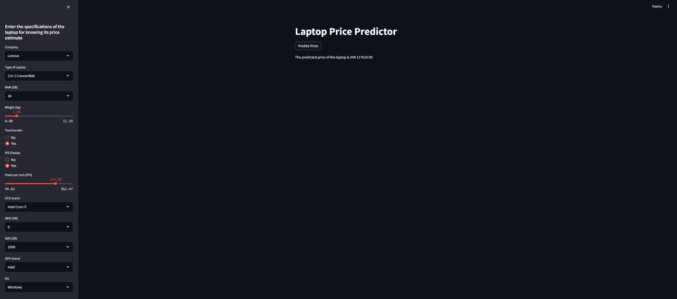
Streamlit App – Laptop Price Predictor
The Residuals Plot for RF Regressor Model depicts the following:
Training Data R2 Score is 95%
Test Data R2 Score is 88%
This shows us that the model is neither overfitting nor underfitting – rather it is the best fit we could get.
The dispersion and distribution of residuals in the chart for train vs. test is also fairly well-distributed, which indicates that the model is able to generalize well for predicting prices of laptops

Slide 25
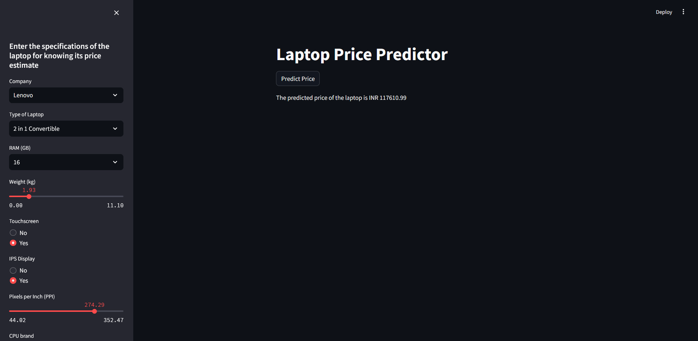
Streamlit App – Laptop Price Predictor
The Residuals Plot for RF Regressor Model depicts the following:
Training Data R2 Score is 95%
Test Data R2 Score is 88%
This shows us that the model is neither overfitting nor underfitting – rather it is the best fit we could get.
The dispersion and distribution of residuals in the chart for train vs. test is also fairly well-distributed, which indicates that the model is able to generalize well for predicting prices of laptops

Slide 26

Flow of the Presentation
Insights – Summary
Insights – Deep Dive
Machine Learning Model
Interface for Laptop Price Prediction
Recommendations – The Way Forward

Slide 27

The Customer’s Dilemma
The average customer has a dilemma when he comes to purchase a laptop at the retail store.
He has several brands to choose from. Within these brands he has several choices of specifications. Within each choice of specifications he has brands he can choose from (such as GPU brands) and so on
He has a limited budget in mind and needs to work within that constraint, but also gain the most value for his money
Laptops are not a frequent purchase – they are durable goods.
Therefore there would be a lot of research and thought before the decision is made to purchase a laptop.
Considering all this, the customer is faced with several CONJOINT CASES when trying to make a decision on which model of laptop to purchase
It is in the retailer’s best interest to find an opportunity in this problem and solve the customer’s dilemma effectively by tailoring services to meet each customer’s unique needs
Dilemmas of Conjoint Cases

Slide 28

The Way Forward – How to Meet Customer’s Unique Needs
By using the pre-existing customer data, SmartTech can do a customer segmentation project that would help:
Segment the customers by demographics and/or geographies
Understand the types of laptops and budget-groups each of these customers generally purchase
Understand each segment’s different usage, attitudes and needs within the category of laptops
With this deeper understanding of its customers, SmartTech could do the following:
Equip and train store personnel to recognize each segment of customers when they enter and enquire at the store
Store personnel can tailor the advise provided on laptops to suit that segment and their budget
Segment-specific offers could be provided by SmartTech to help increase the sales in certain seasons when sales are higher
Customer Segmentation

Slide 29


The Way Forward
Price Estimation:
Given the existing data on general prices in the retail laptop selling market and high-level competition price data, price changes could be estimated which would help forecast future sales trends as well.
Demand Estimation:
With the help of inventory and sales data of the store, future demand trends could be forecasted, which helps in maintaining optimal stock levels of different laptops
Market Basket Analysis:
This analysis would help in identifying purchase patterns among customers by using the existing customer purchase datasets, and it is useful to identify and target customers through cross-promotions of products (eg. Cordless mouse/bag/headset sold along with a laptop)
Price & Demand Estimation Analysis
Market Basket Analysis

Slide 30
Thank You
Rachana Gupta | S8237 | DS41A

